Slide 1
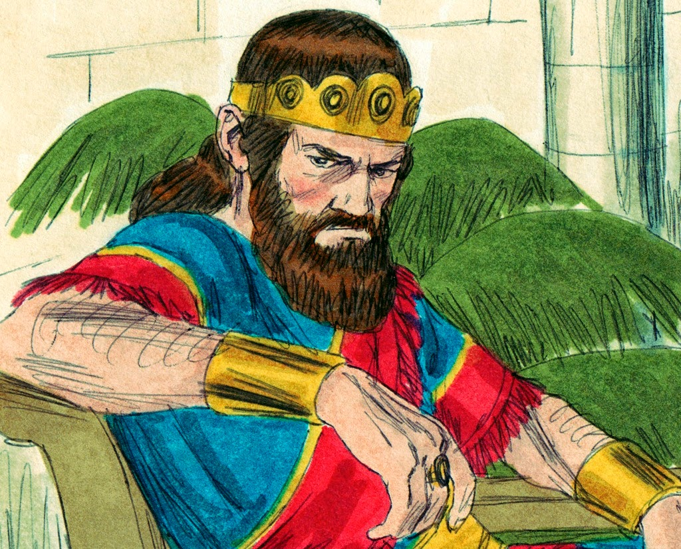
Saul’s Life and Death
1 Samuel ch 13- ch 31

Slide 2
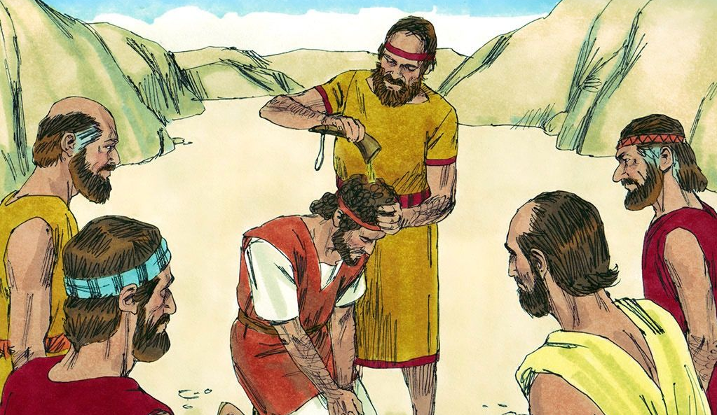
Reminder...
God chose David to be the next king of Israel but David had to wait. David was a great soldier but this made king Saul very jealous and he hunted David and tried to kill him. David loved God but Saul didn’t.

Slide 3
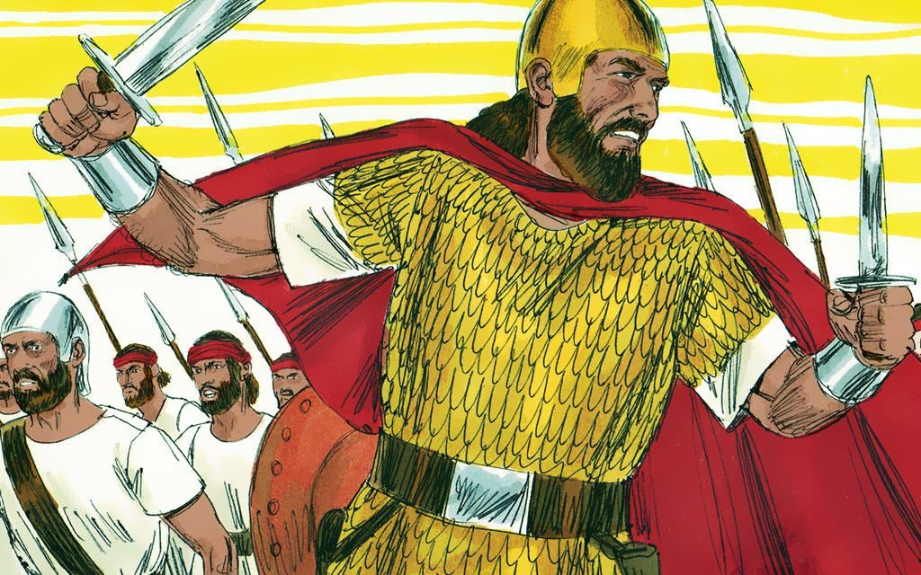
The Israelites had never had a king before, they wanted a king like all the other strong countries. They chose Saul to be their king because he was tall and good looking. Saul did not love God. This made God very unhappy. This was why God chose David to be the next king, he did love God.

Slide 4
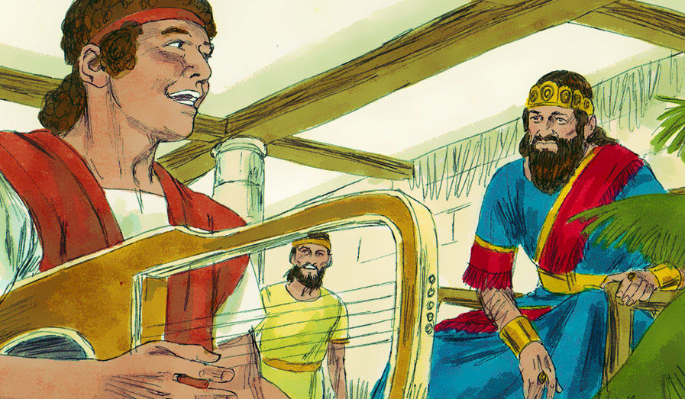
Saul would get very sad and angry. After David went to live in the palace it was part of his job to help make Saul happy. He would go to Saul and play the harp, this would help Saul to be calm and enjoy the beautiful sound of the harp. David was good at everything he did because he did it to please God.

Slide 5
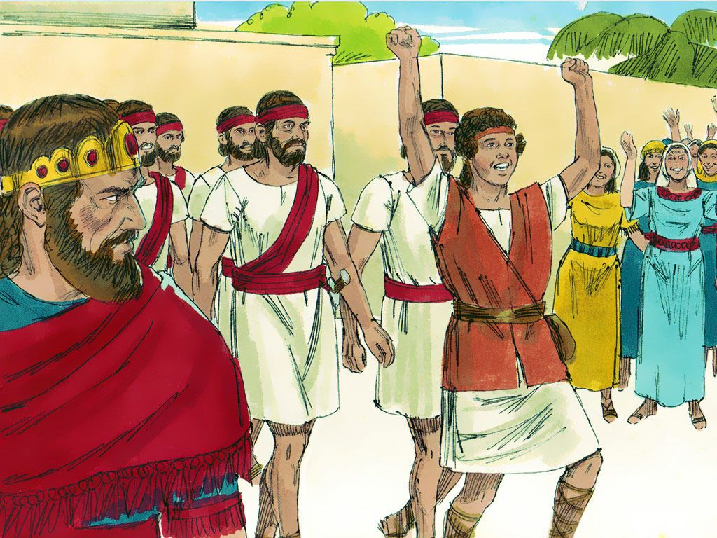
But the more the people loved David the more Saul hated him. He wanted to be seen as the best person in the land , so when he heard the people singing a song about how great David was, Saul began to feel hatred and jealousy towards David.

Slide 6
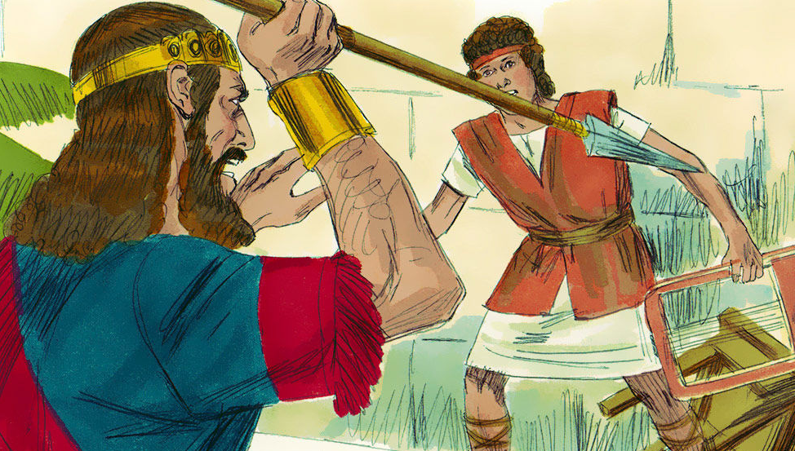
As Saul’s hatred and jealousy of David grew he made a evil plan, he would kill David. Saul was a great man but God is greater. Twice when David was playing the harp for him, Saul took the opportunity to try and kill David. He threw his spear at David but God protected David and he was able to escape the sharp spear.

Slide 7
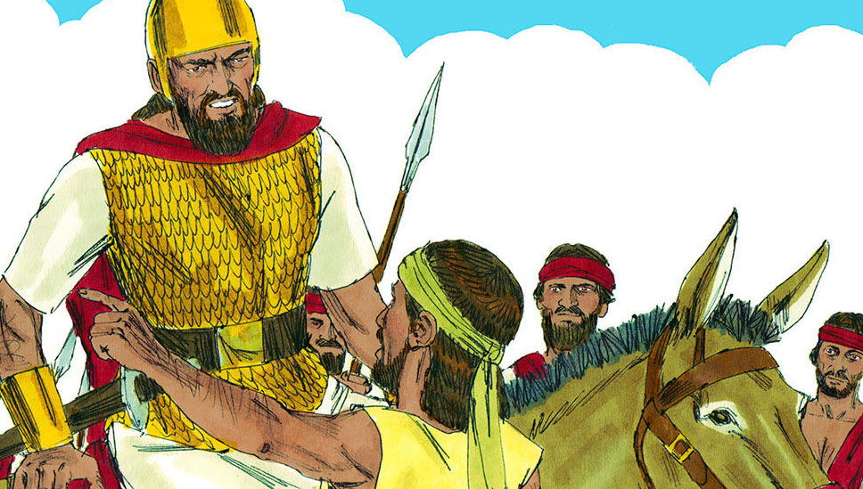
David ran away to escape Saul. Saul and his army of 3000 men went into the mountains and forests to hunt for David to kill him. God was with David and kept him hidden and safe from Saul. One time when Saul got very close to finding him, he received a message to say the Philistines were attacking his country and he needed to return to fight them.

Slide 8
A priest called Ahimehlech was very kind and gave David bread and other things he needed. When Saul heard that the priest had helped David he became very angry and sent his soldiers to kill Ahimelech and 85 other priests. Saul’s heart was so wicked he killed these innocent men just because they helped David. This must have made God very angry with Saul.

Slide 9
David had two opportunities to kill Saul but he knew that would be wrong. Saul said he wouldn’t hurt David but Saul’s heart was still wicked and David could not trust him. David moved to live in the wilderness. God protected him from harm.

Slide 10
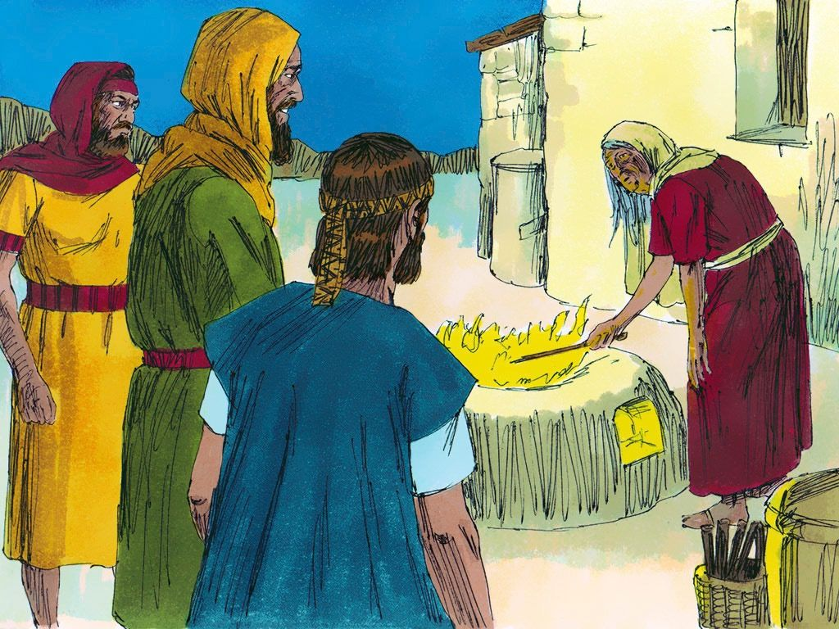
Saul never learned to loved and trust God. When he wanted to know if his army would win another battle against the Philistine army, instead of asking God to help him he did a very bad thing. He dressed as a normal man and went to see a witch to find out what would happen in the battle. Instead of hearing good news Saul was told some very upsetting news. She told him that he was going to die the next day.

Slide 11
During the battle against the Philistine army many of Saul’s soldiers were killed. Saul got hurt very badly. Saul still didn’t ask God to help him. He never said sorry to God for all the wrong things he had done in his life. Instead Saul wanted to die. That day was a very sad day. Saul died in the battle field along with many of his soldiers.

Slide 12
I am sorry that today’s lesson has been such a sad one but God wants us to learn from Saul’s mistakes. Saul never said sorry for the sin in his heart. Saul never loved God or trusted Him.
But
We can be different to Saul.
Jesus died and rose again so that all who believe and say sorry for their sins will be forgiven and one day will go to be with God in heaven. We can’t get to heaven by being nice or good people (although God does want us to be nice and good) but the Bible tells us the only way to heaven is through Jesus Christ, the Son of God.
Jesus said, “I am the way, the truth and the life. No one comes to the Father except through Me.”
John 14 vs 6

Slide 13
This reminds me of a song we sing in Sunday School. See if you can remember it too and sing it to your grownups. It’s called “ I am the way, the truth and the life”
I am the way, the truth and the life,
That’s what Jesus said.
I am the way, the truth and the life,
That’s what Jesus said.
Without the way, there is no going.
Without the truth, there is no knowing.
Without the life, there is no living.
I am the way the truth and the life,
That’s what Jesus said.

Slide 14
Quiz
Was Saul a good king or a bad king?
Did Saul love God?
Did Saul live the way God wanted him to?
How many soldiers did Saul take with him to kill David? A. 30 B. 300 C.3000
Did Saul find and kill David?
Did Saul say sorry to God for his sin?
How can we get to heaven? A. Being good B. Being kind C. Through Jesus

Slide 15
Quiz A
Was Saul a good king or a bad king? BAD KING
Did Saul love God? NO
Did Saul live the way God wanted him to? NO
How many soldiers did Saul take with him to kill David? C.3000
Did Saul find and kill David? NO
Did Saul say sorry to God for his sin? NO
How can we get to heaven? C.Through Jesus

